Slide 1
Chapter-3:
Operational Amplifier and Applications
Module – 2 : Linear Applications of op-amp
Reference:
Robert L. Boylestad, Louis Nashelsky, Electronic Devices & Circuit Theory, 11th Edition, PHI, 2012
Linear IC’s and Its applications By Roy Choudhary

Slide 2
Module 2: Linear Applications of op-amp
Learning Outcomes:
At the end of this module, students will be able to:
2. Discuss OPAMP based amplifier topologies.
3. Analyse and design OPAMP based circuits for simple
mathematical operations.

Slide 3
OPAMP APPLICATIONS
Operational amplifiers are used in two ways.
Linear (small signal) mode:
Non Linear (large signal) mode:
Notes:
Linear (small signal) mode:
Any change in the input difference voltage, $±Vid$produces a proportional output voltage V_{o}
The range of input difference voltage to operate the op.amp in linear region is approximately equal to 100 mv.
Non Linear (large signal) mode:
Beyond 100mv of $±Vid$, the output becomes close to $+Vcc$or $−Vcc$ based on the mode in which the op.amp is used (inverting or non inverting mode).

Slide 4

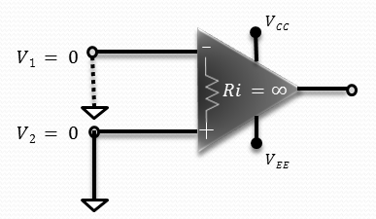
CONCEPT OF VIRTUAL GROUND
Department of Electronics and Communication Engineering, MIT, Manipal
Notes:
An ideal Op-Amp is perfectly balanced. i.e., the output will be zero when input voltages are equal.
Hence when output voltage $Vo = 0$, both the input voltages are equal ie $V1 = V2$.
Since the input impedances of an ideal Op-Amp is infinite ($Ri =∞$), there is no current flow between the two terminals.
Hence when one terminal (say V₂) is connected to ground (ie $V2 = 0$), then because of virtual ground V₁ will also be zero.

Slide 5
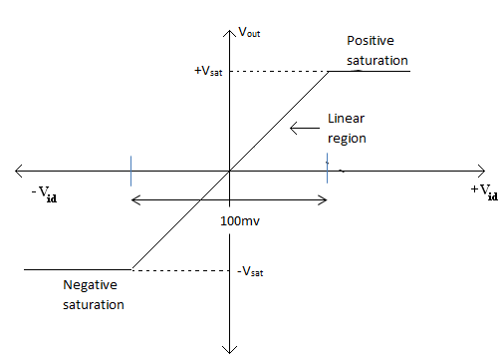
TRANSFER CHARACTERISTICS
Figure: Transfer Characteristics of a typical op-amp

Slide 6
LINEAR APPLICATIONS OF OPAMP
Inverting amplifier
Non-inverting amplifier
Voltage follower
Inverting summing amplifier
Difference amplifier
Integrator
Differentiator
Notes:
Linear applications of op-amp include mathematical operations such as inversion, addition, subtraction, integration, differentiation, and multiplication etc.

Slide 7
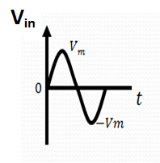
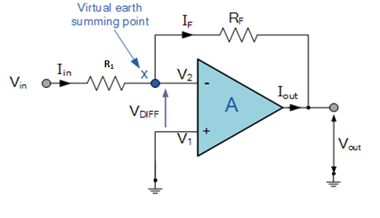
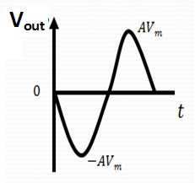
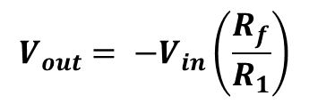
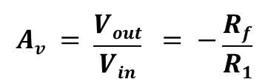
INVERTING AMPLIFIER
$$V_{out}= −V_{in}\left(\frac{R_{f}}{R_{1}}\right)$$
The closed loop voltage gain:
$$Av = \frac{Vout}{Vin} = −\frac{Rf}{R1}$$
Figure: Circuit configuration of inverting op-amp
Ref: Linear appln.docx
Notes:
In Inverting amplifier, the output voltage is out of phase with input V_{in}

Slide 8
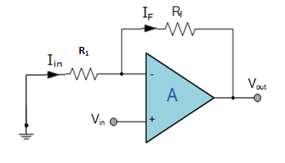
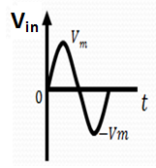
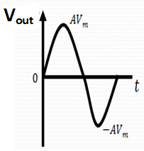
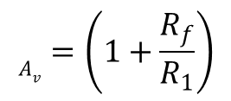
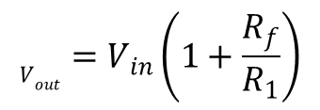
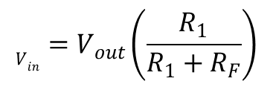
NON-INVERTING AMPLIFIER
$$V_{in}=V_{out}\left(\frac{R_{1}}{R_{1}+R_{F}}\right)$$
$$V_{out}=V_{in}\left(1+\frac{R_{f}}{R_{1}}\right)$$
The closed loop voltage gain for non-inverting amplifier is given by,
$$A_{v}=\left(1+\frac{R_{f}}{R_{1}}\right)$$
Figure: Circuit configuration of non-inverting amplifier
Notes:
In non-inverting amplifier, the output voltage is in phase with input V_{in} .
The voltage gain is ≥ 1

Slide 9
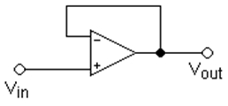

VOLTAGE FOLLOWER
It is used as a buffer amplifier to eliminate loading effects or as an impedance matching device.
The closed loop gain of non-inverting amplifier is
$$A_{v}=\left(1+\frac{R_{f}}{R_{1}}\right)$$
Substituting R_{f} = 0 and R₁ = ∞ in above equation
Figure: Circuit configuration of voltage follower
V_{out} = V_{in}

Slide 10
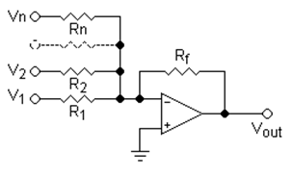
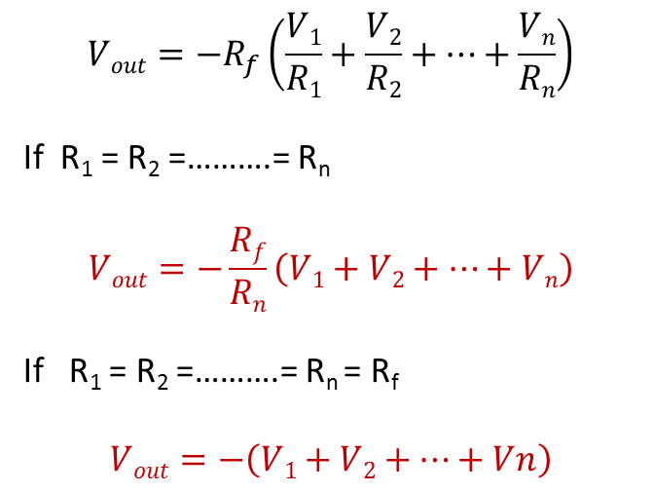
INVERTING SUMMING AMPLIFIER
In an inverting summing amplifier, the o/p voltage id proportional to sum of the inputs
$$Vout=−R_{f}\left(\frac{V1}{R1}+\frac{V2}{R2}+…+\frac{Vn}{Rn}\right)$$
If R₁ = R₂ =……….= R_{n}
$$Vout=−\frac{Rf}{Rn}\left(V1+V2+…+Vn\right)$$
If R₁ = R₂ =……….= R_{n} = R_{f}
$$Vout=−\left(V1+V2+…+Vn\right)$$
Figure: Inverting summing amplifier
Ref: Linear appln.docx

Slide 11
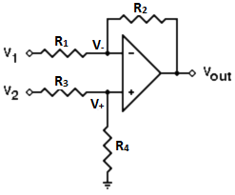
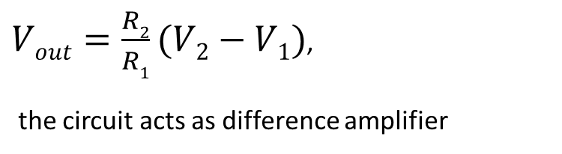
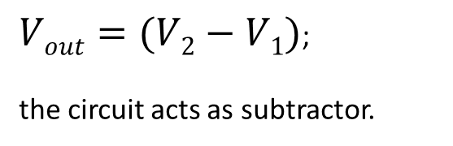
DIFFERENCE AMPLIFIER
$Vout=\frac{R2}{R1}(V2−V1)$,
the circuit acts as difference amplifier
Figure: Difference Amplifier
$Vout=(V2−V1)$;
the circuit acts as subtractor.
Notes:
● It produces an output voltage which is proportional to the difference between the two inputs.

Slide 12
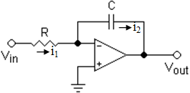
INTEGRATOR
It produces an output voltage which is proportional to the integral of input voltage.
Figure: Integrator circuit
Ref: Linear appln.docx

Slide 13
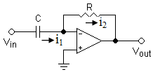
DIFFERENTIATOR
It produces an output voltage which is proportional to the the time derivative of the input voltage.
Fig: Differentiator
Notes:
A differentiator allows all the frequency components above a designed value f_{H} to pass to the output and eliminates all low-frequency components below f_{H}; hence, it is also referred to as a low-frequency discriminator or a high-pass filter

Slide 14
EXERCISE
1.For an OPAMP, when v₁ is 0.5 mV and v₂ is –0.5 mV, output voltage is 8V. For the same OPAMP, when v₁ = v₂ = 1 mV, output voltage is 12 mV. Calculate the CMRR of the OPAMP
Ans: 56.48 dB
2. For an inverting amplifier using OPAMP, R₁=1K, R_{F}=100K, v_{in}=0.1sin(ωt). Find v_{o}.
Ans: –10sin(ωt)
3. For a non inverting amplifier, R₁=10K, R_{F}=100K. Calculate v_{o} if v_{i} = 25 mV dc.
Ans: 275 mV dc
4. An ac signal of rms value 2 mV needs to be amplified to 1.024 V rms, 180 degree phase shifted. Design a suitable amplifier choosing R₁=1.2K
Ans: Inverting amplifier with R_{F}=614.4KΩ

Slide 15
Summary
In this module we have learnt:
Analysis of linear applications of OPAMP.
a. Inverting Amplifier.
b. Non Inverting Amplifier.
c. Voltage follower.
d. Adder.
e. Difference Amplifier
f. Subtractor
g. Integrator
h. Differentiator.

